Slide 1
Structured Programming Language
Nahidul Islam
Lecturer, Dept. of CSE
DCC, Dhaka.
1/31/2023
1

Slide 2
Input and Output
2

Slide 3
Printf () Function
printf() is a library function declared in <stdio.h>
Output data can be written from the computer onto a standard output device using the library function printf() .
That is, the printf() function moves data from the computer’s memory to the standard output device, whereas the scanf function enters data from the standard input device and stores it in the computer’s memory.
In general terms, the printf() function is written as
printf (control string, arg1, arg2, . . . , argn).
where control string or format specifier refers to a string that contains formatting information, and arg7, arg2, . . . , argn are arguments that represent the individual output data items.
3

Slide 4
Printf () Function
The control string consists of individual groups of characters, with one character group for each output data item. Each character group must begin with a percent sign (%). In its simplest form, an individual character group will consist of the percent sign (%) , followed by a conversion character indicating the type of the corresponding data item
4

Slide 5
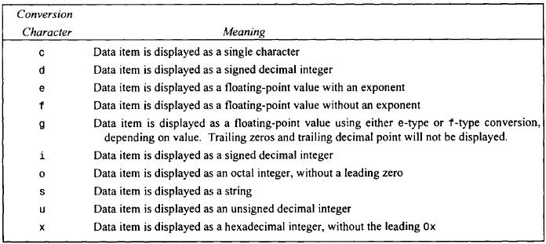
Printf () Function
Commonly used conversion character for data output
5

Slide 6
Printf () Function
Control string or format specifiers:
%c The character format specifier.
%d The integer format specifier.
%i The integer format specifier (same as %d).
%f The floating-point format specifier.
%o The unsigned octal format specifier.
%s The string format specifier.
%u The unsigned integer format specifier.
%x The unsigned hexadecimal format specifier.
%% Outputs a percent sign.
6

Slide 7
Printf () Function
#include <stdio.h>
// program prints hello world
int main() {
printf ("Hello world!");
return 0;
}
#include <stdio.h>
// program prints a number of type int
int main() {
int number = 4;
printf (“Number is %d”, number);
return 0;
}
Output: Hello world!
Output: Number is 4
7

Slide 8
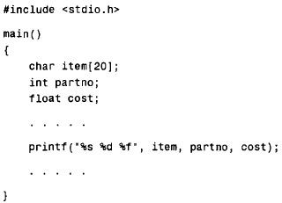
Within the printf function, the control string is "%s %d %f. It contains three character groups.
The first character group, %s, indicates that the first argument (item) represents a string.
The second character group, %d, indicates that the second argument (partno) represents a decimal integer value, and
The third character group, %f, indicates that the third argument (cost)
represents a floating-point value.
8

Slide 9
Let’s Try !!!
A C program contains the following variable declarations.
float a = 2.5, b = 0.0005, c = 3000.;
Show the output resulting from each of the following
printf statements.
printf ( "%f %f %f",a, b, c);
printf('%3f %3f %3f ", a, b, c);
printf( “%8f %8f %8f", a, b, c);
(d) printf("%8.4f %8.4f %8.4f", a, b, c);
(e) printf("%8.3f %8.3f %8.3f", a, b, c);

Slide 10
Scanf ()
scanf() is a library function declared in <stdio.h>
Input data can be entered into the computer from a standard input device by means of the C library function scanf().
This function can be used to enter any combination of numerical values, single characters and strings.
The scanf function is written as
scanf(contro1 string, argl, arg2, . . . , argn)
where control string refers to a string containing certain required formatting information, and argl, arg2, . . . argn are arguments that represent the individual input data items. The arguments are actually pointers that indicate where the data items are stored in the computer's memory.

Slide 11
Scanf ()
The control string consists of individual groups of characters, with one character group for each input data item. Each character group must begin with a percent sign (%).
In its simplest form, a single character group will consist of the percent sign, followed by a conversion character which indicates the type of the corresponding data item.
Each variable name must be preceded by an ampersand (&).

Slide 12
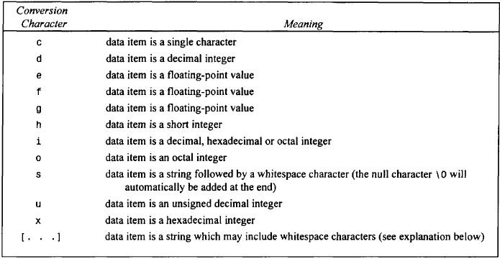
Scanf ()
Commonly Used Conversion Characters for Data Input

Slide 13
1.#include<stdio.h>
int main(){
int number;
printf("enter a number:");
scanf("%d",&number);
printf("cube of number is:%d ",number*number*number);
return 0; 8.}
Output:
enter a number: 5 cube of number is:125
The scanf("%d",&number) statement reads integer number from the console and stores the given value in number variable.
The printf("cube of number is:%d ", number * number * number) statement prints the cube of number on the console.

Slide 14
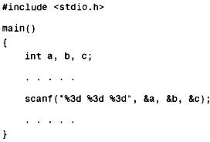
More on scanf()
Consider the C program

Slide 15
More on scanf()
When the program is executed, three integer quantities will be entered from the standard input device (the keyboard).
Suppose the input data items are entered as 1 2 3. Then the following assignments will result: a = 1 , b = 2 , c = 3
If the data had been entered as
123 456 789
Then the assignments would be a = 123, b = 456, c = 789
Now suppose that the data had been entered as
123456789
Then the assignments would be a = 123, b = 456, c = 789
as before, since the first three digits would be assigned to a, the next three digits to b, and the last three digits to c.

Slide 16
More on scanf()
Finally, suppose that the data had been entered as
1234 5678 9
The resulting assignments would now be a = 123, b = 4, c = 567
The remaining two digits (8 and 9) would be ignored, unless they were read by a subsequent scanf statement.

Slide 17
Example of input and output in C language that prints addition of 2 numbers.
#include<stdio.h>
int main(){
int x=0,y=0,result=0;
printf("enter first number:");
5. scanf("%d",&x);
6. printf("enter second number:");
7. scanf("%d",&y);
result=x+y;
printf("sum of 2 numbers:%d ",result);
return 0; 11.}
Output:
enter first number:9 enter second number:9 sum of 2 numbers:18

Slide 18
Thank you

